Slide 1
BIA 650 – Process Optimization and Analytics
4. LP Applications
Linear Programming Theory (ctd.)
Duality
Convergence
Sample LP Application - Data Envelopment Analysis
Case Study – Shelby Company
© E. A. Stohr, 2017

Slide 2
The Dual Problem
To every “primal” LP:
Max c^{t} x
subject to:
A x < b, x > 0
Where x is a column vector, c^{t (}the transform of column vector c) is a row vector).
there corresponds a “dual” LP:
Min y^{t} b
subject to:
y^{t}A > c, y > 0 or A^{t}y > c
Thus, the coefficients of the jth constraint of the dual problem are the coefficients of x_{j} in the primal and vice versa

Slide 3
The Dual Problem
Consider the following primal and dual problems:
Max 2x1 + x2
st: x1 + x2 < 4
x2 < 3 x1, x2 > 0
Min 4y1 + 3y2
St: y1 > 2
y1 + y2 > 1 y1, y2 > 0
In matrix form one can obtain the dual by matrix transposition except that the new objective function becomes the bottom row and the new RHS is on the left:
Primal: Dual:
2 1 0 2 1 0
1 1 4 1 1 1
0 1 3 0 4 3

Slide 4
Primal – Dual Example
PRIMAL
 | x1 | x2
Max Profs | 2 | 1
 |  |  |  |  | RHS
Tech | 1 | 1 | 4 | < | 4
 |  | 1 | 0 | < | 3
Decs | 4 | 0
Max
Obj | 8
DUAL
 | Y1 | y2
Min Costs | 4 | 3
 |  |  |  |  | DualRHS
DualTech | 1 | 1 | 2 | > | 1
 | 1 |  | 2 | > | 2
DualDecs | 2 | 0
Min
DualObj | 8

Slide 5
Simplex Algorithm and Dual
The solution to the dual can be read from the optimal solution to the primal (and vice versa)
From the observations in the previous lecture. In the optimal primal solution:
The value of the optimal solutions are the same (duality):
Y₀* = ∑biYi* = ∑CjXj* = X₀*
(∑a_{ij} Yi – Cj ) > 0 by definition of optimality. Hence, Yi is feasible for the dual.
3. The row 0 coefficient of the i^{th} slack = Yi* (Observation 5)

Slide 6
Dual Theorem
Theorem 1: The dual of the dual is the primal.
Theorem 2: (Dual Theorem):
If both the primal and dual problems have feasible solutions then both have optimal solutions, x* and y*, respectively, such that:
C^{t}.x* = y*^{t}.b
Step 1 in Proof:
Assuming that x and y are feasible solutions to the primal and dual, respectively, the following shows that any feasible solution of the dual is an upper bound on any feasible solution of the primal (see next slide) --

Slide 7
Duality Theory (ctd)
Max ∑ c_{j}.X_{j}
^{j}
st: ∑ a_{ij}.Xj < b_{i}, i = 1, 2 ,…, m (1)
^{j}
Min ∑ b_{i}.Y_{i}
^{i}
st: ∑ a_{ij}.Yi > c_{j}, j = 1, 2 ,…, n (2)
^{j}
Multiply each equation in (1) by Y_{i} and sum over i
∑Y_{i} ∑ a_{ij}.Xj < ∑Y_{i} b_{i}, (3)
i j i
Multiply each equation in (2) by X_{j} and sum over j
∑X_{j} ∑ a_{ij}.Y_{i} > ∑X_{j} c_{j}, i = 1, 2 ,…, m (4)
j i j
then
∑ b_{i}.Y_{i} > LHS(3) = LHS(4) > ∑ c_{j.}X_{j} (5)
i j

Slide 8
Complementary Slackness
From (3) and the Dual Theorem, at the optimal point:
∑Y*_{i} ∑ a_{ij}.Xj = ∑Y*_{i} b_{i},
i j i
then Y*_{i} (∑ a_{ij}.X*_{j} - b_{i}) = 0 for each i (product of 2 non-negatives)
^{j}
Hence, if Y*_{i} > 0 then (∑ a_{ij}.X*_{j} - b_{i}) = 0
^{j}
and if (∑ a_{ij}.X*_{j} - b_{i}) > 0 then Y*_{i} = 0
^{j}
Thus, if a dual variable is positive in the optimal dual solution the corresponding constraint in the primal is tight (satisfied exactly.)
Similarly, if a primal variable is positive in the optimal solution the corresponding constraint in the dual is tight (satisfied exactly.)

Slide 9
LP Convergence Properties
Suppose each step of the Simplex algorithm improves the value of the objective function, then, if the problem is unbounded, the algorithm will finish in a finite number of steps.
Convergence – that the simplex algorithm will reach an optimal state in a finite number of iterations has not been proved in general because cycling is conceivable. i.e. the algorithm takes steps with zero improvement in the objective. But this is not a problem in practice.
Roughly speaking, the computational complexity increases as the cube of the number of constraints.

Slide 10
Efficiency: Economist’s Viewpoint
Input Efficiency
The firm is optimally using the factors of production
Allocative Efficiency: Inputs are combined in optimal proportions
Technical Efficiency: No more of each input is used than should be required to produce a given level of output
Output Efficiency
The firm produces the correct combination & level of outputs.
Scale efficiency: The firm maximizes the ratio of outputs to inputs.
Scope efficiency: The firm jointly produces two or more outputs more efficiently than it could produce each of the outputs separately.
Notes:
Allocative Efficiency: Occurs when inputs are combined in optimal proportions e.g. an efficient high tech (capital intensive) firm uses a lot less labor than a low tech firm.
Scale efficiency: Occurs when a firm is operating at a level that maximizes the ratio of outputs to inputs.
If there are increasing returns to scale, then the firm should produce more (if the market allows) (and vice versa for decreasing returns). If we assume constant returns to scale, output efficiency and technical input efficiency coincide.
Scope efficiency: Occurs when the firm jointly produces two or more outputs more efficiently than it could producing each of the outputs separately.
Which efficiency is addressed by a merger with a similar firm?
Which efficiency does BPR address?
Which dot-com is using scope efficiency?
Are there any other ways in which a firm can become more efficient?

Slide 11
Data Envelopment Analysis
There are many similar productive units (e.g. bank branches, franchise restaurants, hotels in a chain).
Each unit has several different inputs and outputs.
Which units are the most efficient?
How can we improve inefficient units?
Data Envelopment Analysis (DEA) uses linear programming techniques to find the “best practice” firms or productive units. For each firm, we find “reference firms” - the firms that are most like it in terms of input mix and are, relatively, the most efficient. These efficient firms lie on the “efficiency frontier”. Firms that do not lie on this frontier are considered inefficient and their inefficiency is measured by their distance from the frontier (e.g. the distance from the origin to E2 in the following figure).

Slide 12
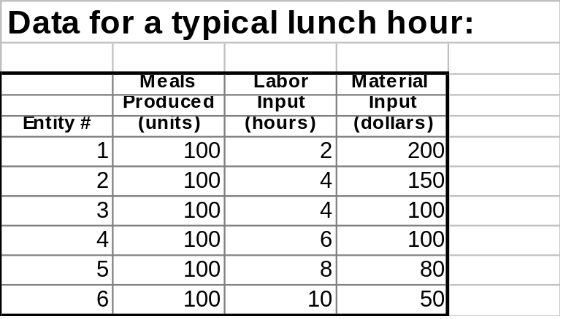
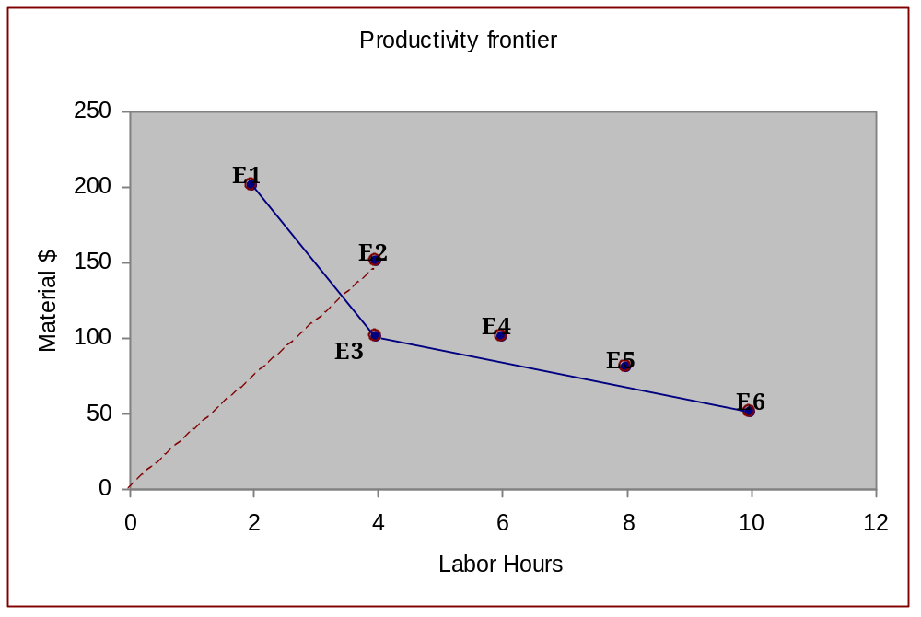
Data Envelopment Analysis
Burger Palace Example
Technical efficiency of E2 = OE*/OE2 (<1)
Efficiency Frontier
E*
Notes:
Production frontier = efficiency frontier
Note that the efficiency frontier is an empirical concept. If data is collected on hundreds of firms, the efficiency frontier can be approximated by a smooth curve.
DEA assumes that “smooth” trade-offs can be made – i.e., that an inefficient firm can make itself more efficient by decreasing the different types of input in the correct proportions to move it onto the efficiency frontier.

Slide 13
DEA Intuition
Efficiency = Outputs (weighted sum) / Inputs (weighted sum) < 1
For each DMU, k, in turn, find the sum of weights for inputs and outputs that makes it look best relative to all other DMUs
[Normalize the sum of input weights for DMU, k, to equal 1]
Constrain the efficiencies of all the DMUs to be < 1

Slide 14
Algebraic Formulation of DEA
The efficiency of a DMU, k (k=1.2 .., K) is simply the ratio of the inputs to the outputs, and is constrained to be no more than 1. The goal is to find a set of input weights (prices), vj, and output weights (values), wi, that puts the target DMU in the best possible light. Note: In the following, Xjk and Yik are empirical DATA.
m n
Max zk = ∑ui.Yik / ∑vj.Xjk (Outputs / Inputs = efficiency of DMU k)
i=1 j=1
Subject to: = ∑ui.Yik / ∑vj.Xjk < 1 for all DMUs, k = 1,2,..,K
i j
ui > 0, vj > 0 for all i, j
Yik is the amount of the ith output and Xjk is the amount of the jth input of DMU k
For a specific DMU, 0, this is equivalent to solving the linear program:
    m
    Max z0 = ∑ui.Yi0 z0 = efficiency of DMU 0
    i=1
    ∑vj.Xj0 = 1
    j
    ∑ui.Yik - ∑vj.Xjk < 0 for all DMUs, k = 1,2,..,K
    ui > 0, vj > 0 for all i, j

Slide 15
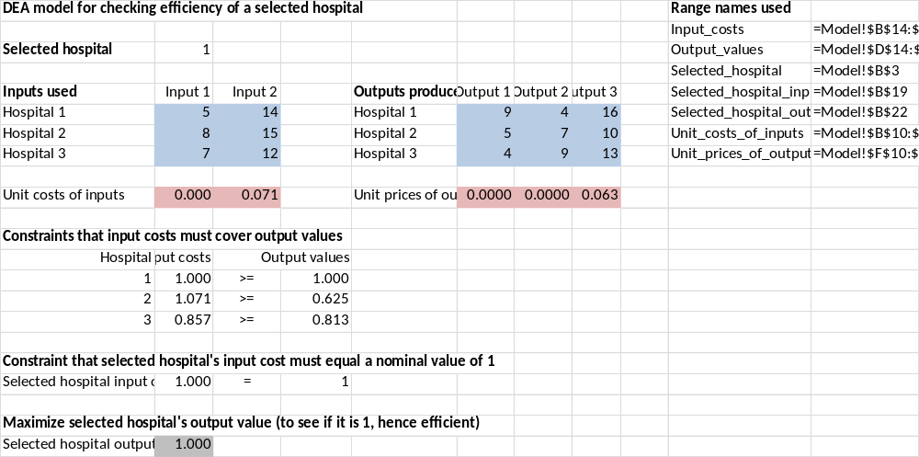
DEA Formulation (W&A Ex. 4.8)
Problem: Given the inputs and outputs of the 3 hospitals, which ones are efficient?
Inputs:
Capital (100’s of hospital beds)
Labor (100’s of labor hours)
Outputs: 100’s of patient days
Patients under 14 years old
Patients between 14 and 65
Patients over 65
=vlookup(Selected_hospital,A14:D16,4)

Slide 16
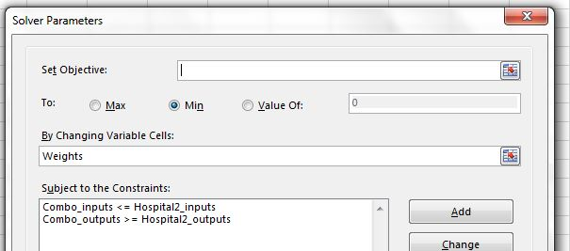
Hospital DEA (ctd)
Comparing combination of hospitals 1 and 3 to inefficient hospital 2
 | Weights |  | Input 1 | Input 2 |  | Output 1 | Output 2 | Output 3
Hospital 1 | 0.2615 |  | 5 | 14 |  | 9 | 4 | 16
Hospital 3 | 0.6615 |  | 7 | 12 |  | 4 | 9 | 13
Combination |  |  | 5.938 | 11.6 |  | 5 | 7 | 12.785
 |  |  | <= | <= |  | >= | >= | >=
Hospital 2 |  |  | 8 | 15 |  | 5 | 7 | 10

Slide 17
Applications of DEA
Branch banks
ATMs
Hospitals
Police forces
Franchise operations
Baseball players
Schools – K-12 headstart
Relative productivity of countries
Example
A government authority can choose DEA as their measuring tool to design an individualized regulatory rate for electric utilities firms based on their comparative efficiency. The input components are man-hours, losses, capital (lines and transformers only), and goods and services. The output variables are number of customers, energy delivered, length of lines, and degree of coastal exposure.
.

Slide 18
DEA: Advantages & Disadvantages
Advantages
DEA can handle multiple inputs and multiple outputs
It doesn't require an assumption of a functional form relating inputs to outputs.
DMUs are directly compared against a peer or combination of peers.
Inputs and outputs can have very different units. For example, X1 could be in units of lives saved and X2 could be in units of dollars without requiring an a priori tradeoff between the two.
Disadvantages
Difficult to determine the appropriate inputs and outputs for the DMUs
Does not rank the efficient units
The more inputs and outputs there are, the more units on the frontier
Statistical tests are not possible.

Slide 19
Shelby Case 3.1 Some Accounting Terms
Direct Costs:
Costs that can be directly observed as being consumed by a product or service/process
Examples: Direct Labor Cost, Direct Material Cost
Indirect (overhead) Costs:
Costs that are incurred but cannot be directly associated with particular products or services/processes
Examples: Supervision, space, heating
Variable Costs
Costs that vary with the level of production of a product or service
Fixed Costs
Costs that do not vary with the level of output. Fixed costs can change only over the long run.
Examples: Administration, Investment in plant and equipment (amortized or rental costs).
Fixed overhead costs are incurred even at zero levels of production (e.g., rent)
Variable overhead costs vary with the total output of the organization (e.g., power consumption)

Slide 20
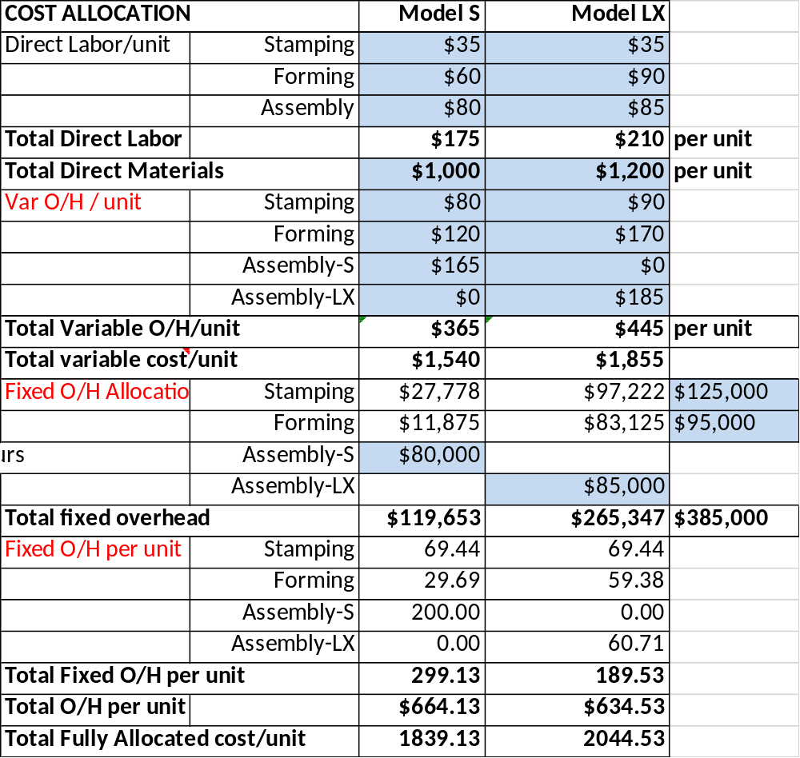
Shelby Overhead Allocation
Manufacturing Process
(Showing Overheads allocated to each department)
Assemble S
$80K
Stamping
$125K
Forming
$95K
S
LX
Assemble LX
$85K

Slide 21
Shelby (Overhead Allocation continued)
 | Model S | Model LX |  |  | CURRENT Production Schedule
Stamping | $35 | $35 |  |  | Overhead Allocation Calculations
Forming | $60 | $90 |  |  | Machine requirements (hours per unit)
Assembly | $80 | $85 |  |  |  | Model S | Model LX
 | $175 | $210 | per unit |  | Stamping | 0.3 | 0.3
 | $1,000 | $1,200 | per unit |  | Forming | 0.25 | 0.5
Stamping | $80 | $90
Forming | $120 | $170 |  |  | Current monthly | Model S | Model LX
Assembly-S | $165 | $0 |  |  | production | 400 | 1400
Assembly-LX | $0 | $185
 | $365 | $445 | per unit |  | Hours spent in departments
 | $1,540 | $1,855 |  |  |  | Model S | Model LX | Totals
Stamping | $27,778 | $97,222 | $125,000 |  | Stamping | 120 | 420 | 540
Forming | $11,875 | $83,125 | $95,000 |  | Forming | 100 | 700 | 800
Assembly-S | $80,000
Assembly-LX |  | $85,000 |  |  | Percentages of time spent in departments
 | $119,653 | $265,347 | $385,000 |  |  | Model S | Model LX
Stamping | 69.44 | 69.44 |  |  | Stamping | 22.2% | 77.8%
Forming | 29.69 | 59.38 |  |  | Forming | 12.5% | 87.5%

Slide 22
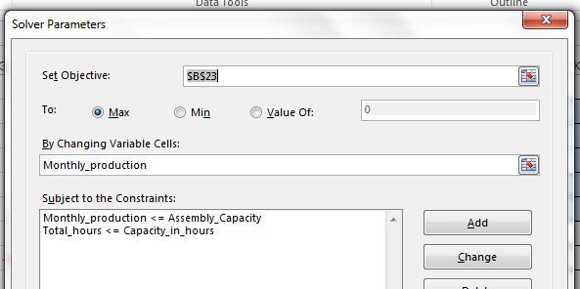
Solver Solution to Shelby
SENSITIVITY ANALYSIS
Variable Cells
 |  |  | Final | Reduced | Objective | Allowable | Allowable
 | Cell | Name | Value | Cost | Coefficient | Increase | Decrease
 | $B$12 | Monthly production Model S | 1900 | 137.5 | 260 | 1E+30 | 137.5
 | $C$12 | Monthly production Model LX | 650 | 0 | 245 | 275 | 245
Constraints
 |  |  | Final | Shadow | Constraint | Allowable | Allowable
 | Cell | Name | Value | Price | R.H. Side | Increase | Decrease
 | $D$17 | Stamping Total hours | 765 | 0 | 800 | 1E+30 | 35
 | $D$18 | Forming Total hours | 800 | 490 | 800 | 58.33333333 | 325

Slide 23
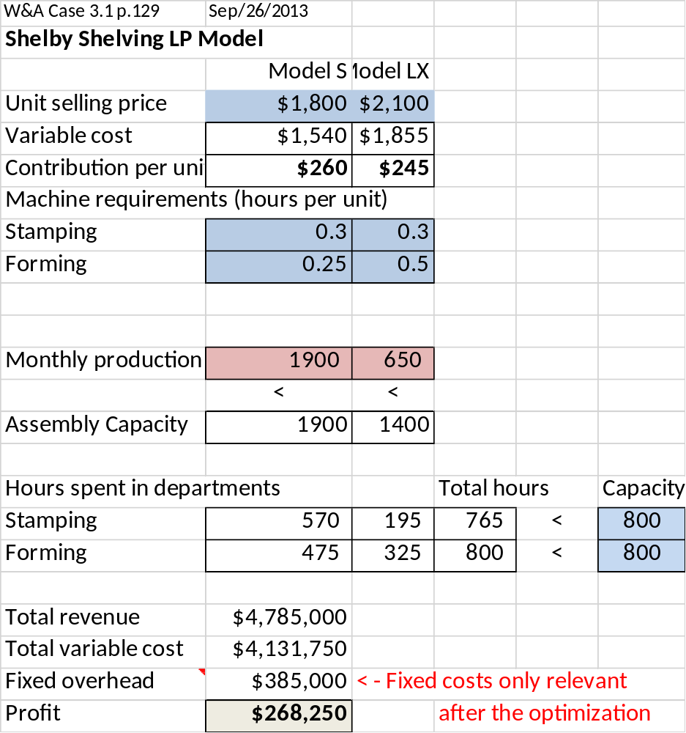
LP Solution
< - Total direct & variable
O/H costs per unit
Shelby WAS producing 400
Model S and 1400 Model LX !

Slide 24
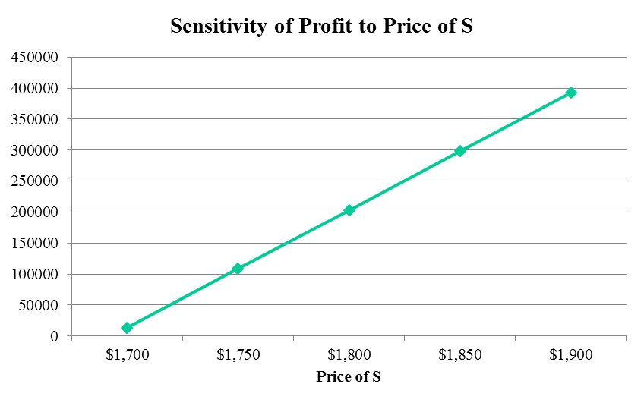
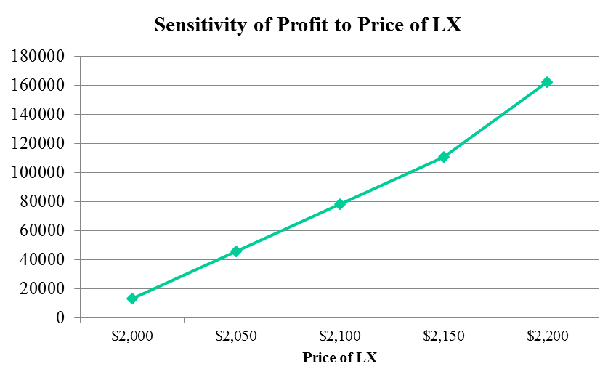
Sensitivity of Profit to Prices

